Slide 1
Learning & Development Enabling development, Impacting growth…
BIG-04
MAP REDUCE – Module 04

Slide 2
Module outline
What is Map Reduce
Input Splits
Map Reduce Job Submission
Map Reduce Functions
Map Reduce in Hadoop
Word Count Execution
Components in a Hadoop MR Workflow
Q & A

Slide 3

What is Map Reduce
Programming model for data processing for clusters of commodity machines
Pioneered by Google
Processes 20 PB of data per day
Popularized by open-source Hadoop project
Used by Yahoo, Facebook, Amazon etc
Simple Implementation model
Implementation can be done in Java, ruby, python, C++ etc.
No need to worry about shipment, rack, distribution, JVM etc.

Slide 4
Map Reduce(continued)
"Map" step:
Is just a data preparation step
Program split into pieces
Worker(Slave) nodes process individual pieces in parallel (under global control of the Job Tracker node)
Each worker node stores its result in its local file system where a reducer is able to access it
"Reduce" step:
Data is aggregated (‘reduced” from the map steps) by worker nodes (under control of the Job Tracker)
Multiple reduce tasks can parallelize the aggregation
Aggregation logic is applied in this phase

Slide 5
Map Reduce(continued)
Input to Mapper (map phase) is always an input split.
An input split is a logical division of data.
Input and output of map reduce is always a Key-Value pair.
Mapper is just a data preparation phase.
Actual aggregation logic is applied in Reducer phase.
Merge and sort is done by framework after map phase.

Slide 6
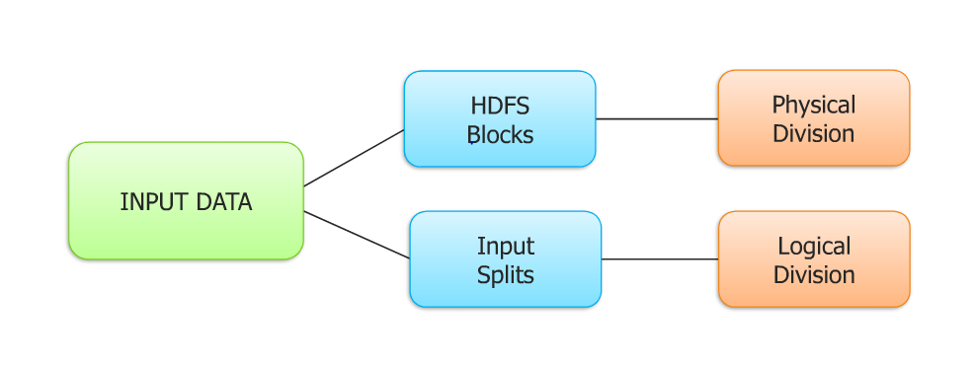
Input Splits

Slide 7
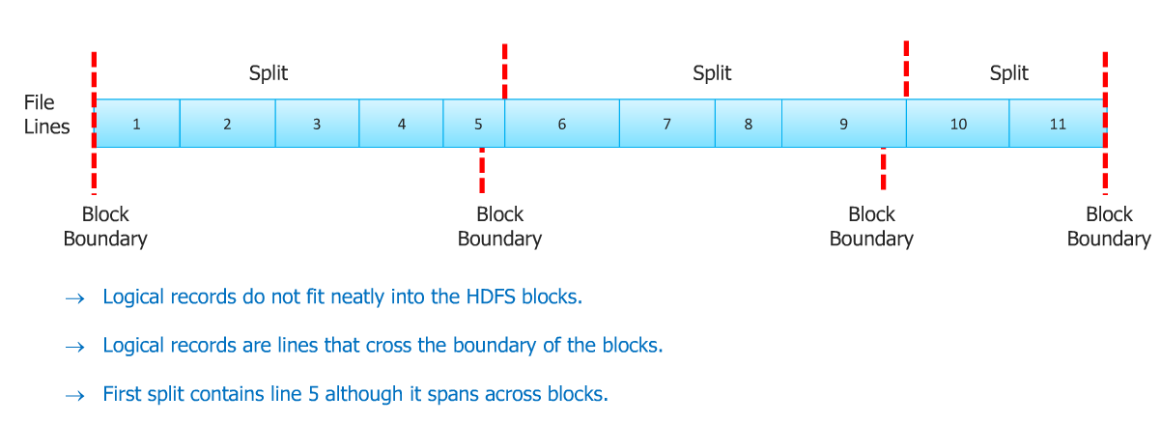
Relation between blocks and input splits

Slide 8
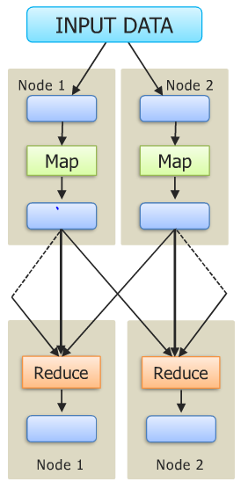
Map Reduce Job Submission
Each Map task works on a split data
Mapper outputs intermediate data
Sort and merge is performed based on key
Reducer output is stored in different nodes

Slide 9
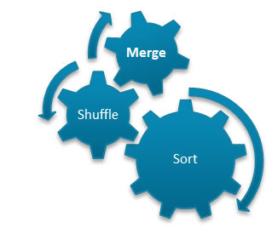
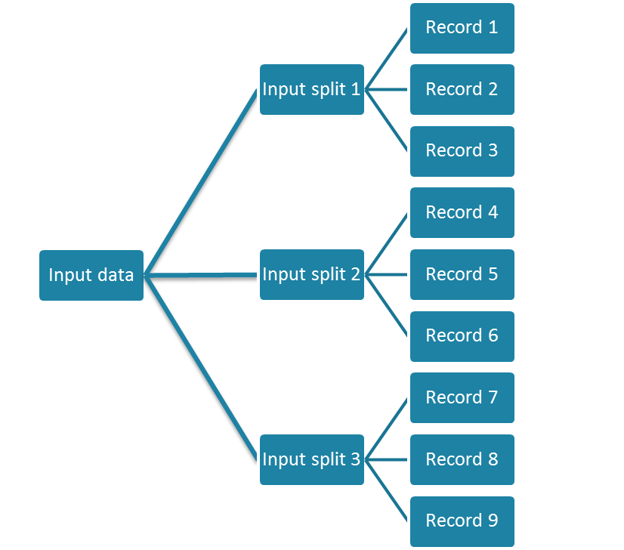
Map Reduce(continued)
Task1
Aggregated Result
Task 2
Output data
Aggregated Result
Task 3

Slide 10
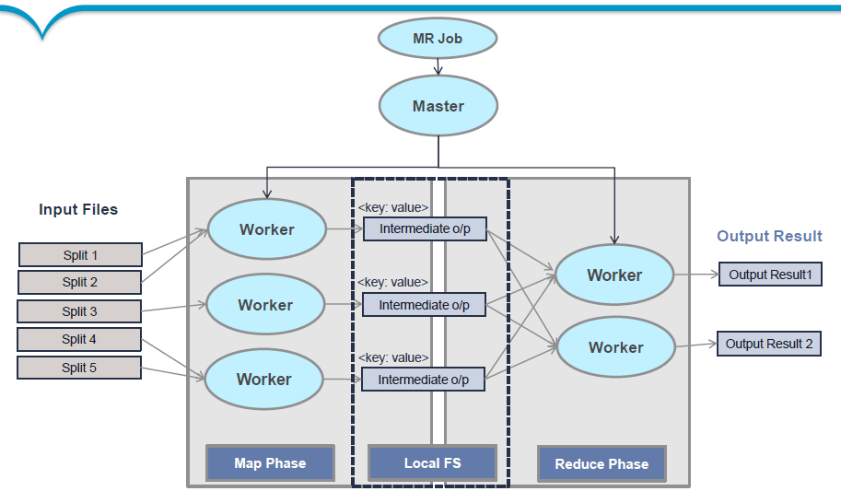
Map Reduce(continued)

Slide 11
Map Reduce Functions
Map Function:
Input Output
Reduce Function:
Input Output
(K1,V1)
(K2,V2)
(K2, list(V2))
(K3,V3)

Slide 12
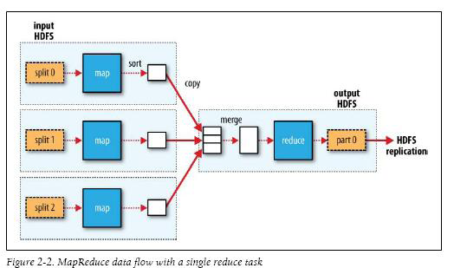
Map Reduce in Hadoop-1

Slide 13
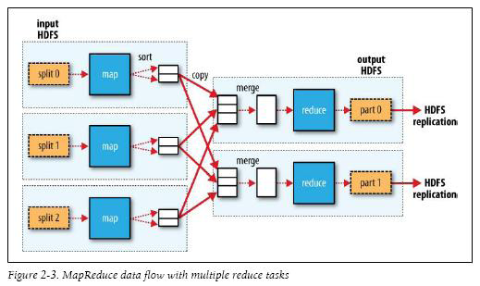
Map Reduce in Hadoop-2

Slide 14
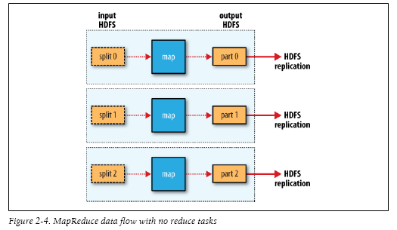
Map Reduce in Hadoop-3

Slide 15
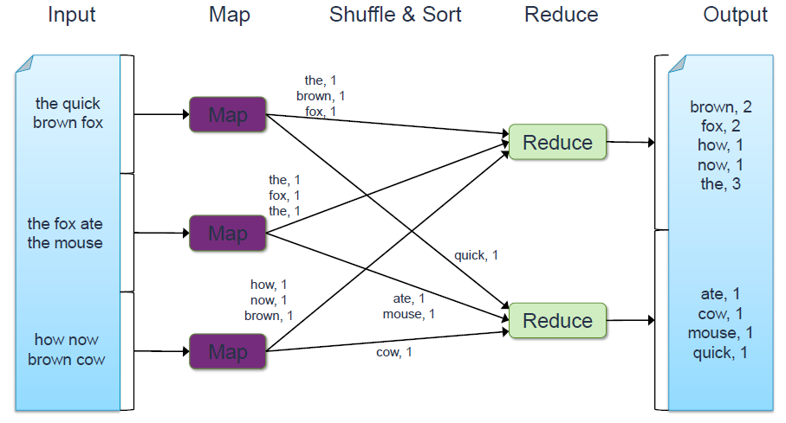
Word Count Execution

Slide 16
Word Count Execution

Slide 17
An Optimization: The Combiner
A combiner is a local aggregation function for repeated keys produced by same map
For associative ops. like sum, count, max
Decreases size of intermediate data

Slide 18
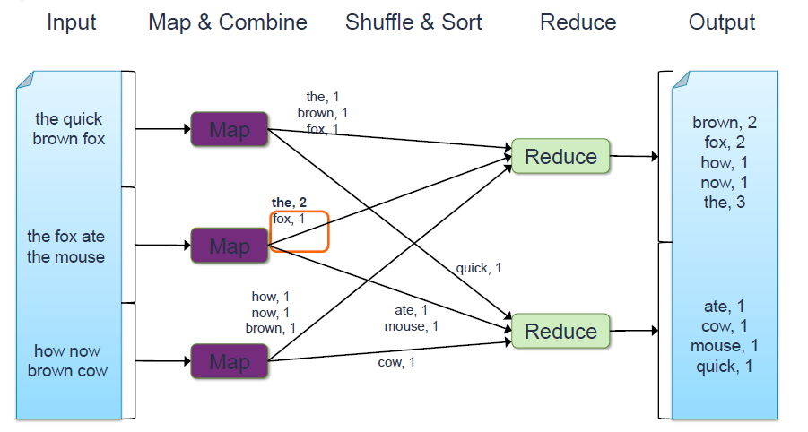
Word Count with Combiner

Slide 19
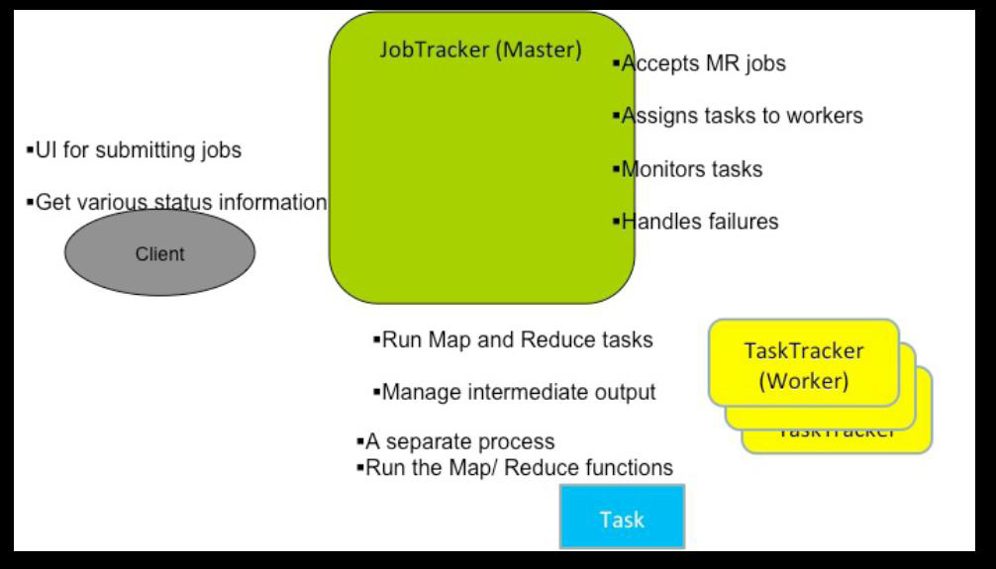
Components in a Hadoop MR Workflow

Slide 20
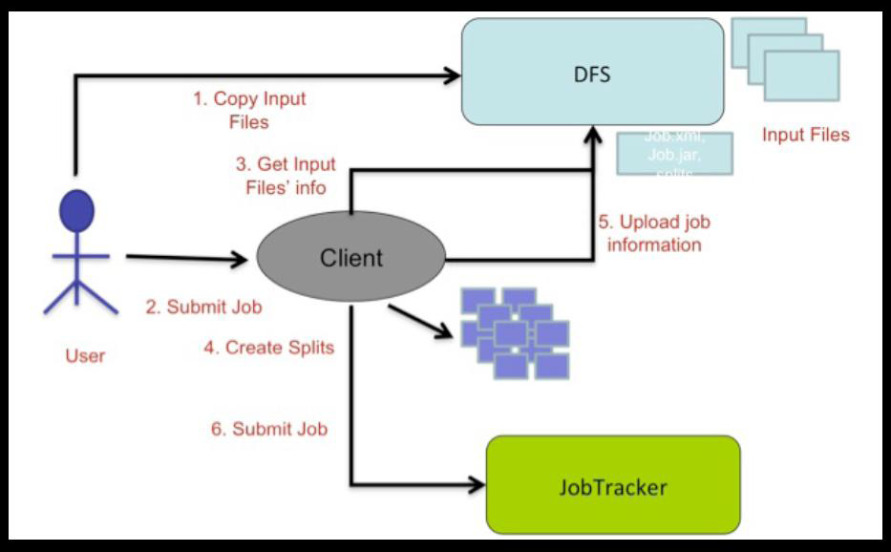
Job Submission

Slide 21
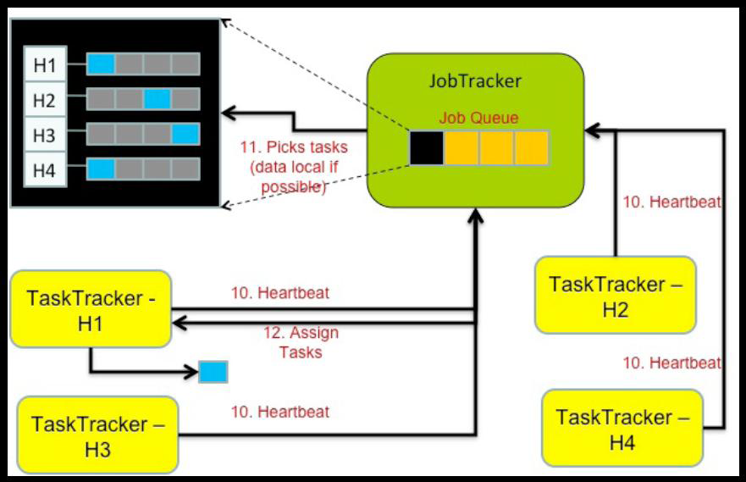
Scheduling

Slide 22
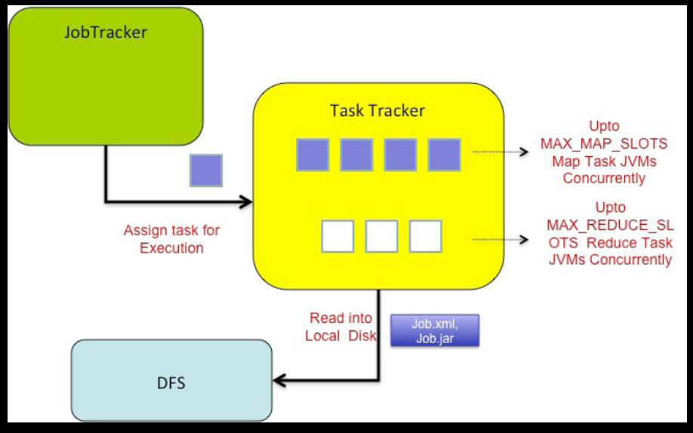
Execution

Slide 23
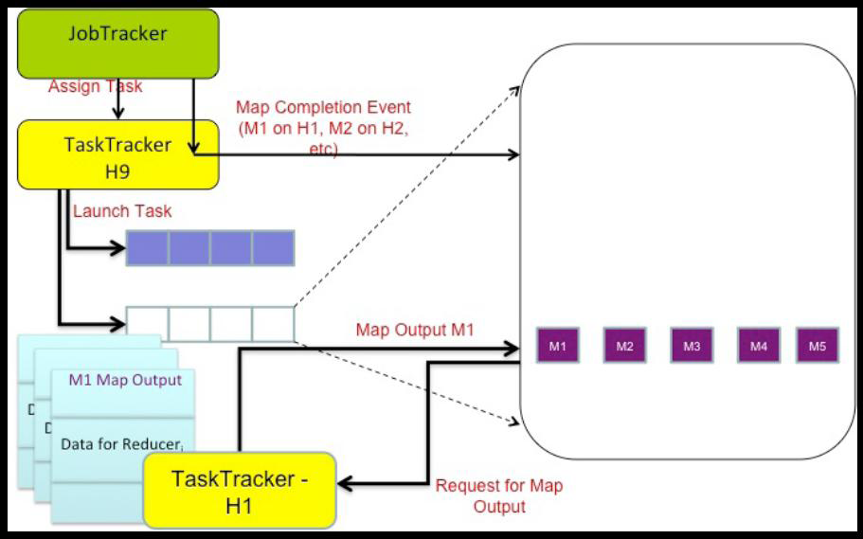
Reduce Tasks

Slide 24
Execution

Slide 25
Quiz
1. Input to Map Reduce is in the form of:
List of values
Array of values
Key-Value pair
None of the above
2. Input splits are:
Logical division of data
Physical division of data
Both A & B
None of the above

Slide 26
Quiz-Answers
1. Input to Map Reduce is in the form of:
List of values
Array of values
Key-Value pair
None of the above
2. Input splits are:
Logical division of data
Physical division of data
Both A & B
None of the above
C: Key-Value Pair
A: Logical division

Slide 27
Quiz
3. Combiners are also called:
Mini mappers
Mini reducers
Map phase
Key-Value pairs
4. True or False? MapReduce can best be described as a programming model used to develop Hadoop-based applications that can process massive amounts of unstructured data.
True
False

Slide 28
Quiz-Answers
3. Combiners are also called:
Mini mappers
Mini reducers
Map phase
Key-Value pairs
4. True or False? MapReduce can best be described as a programming model used to develop Hadoop-based applications that can process massive amounts of unstructured data.
True
False
B: Mini Reducers
A: True

Slide 29
Q & A

Slide 30
Thank You

